Slide 1

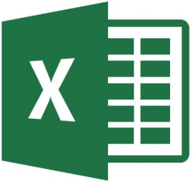

ControlFile.json
DataFrame
Source.xlsx
Target.xlsx
Source Template.xlsx
Output Template.xlsx

Slide 2
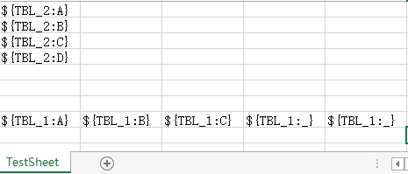

Slide 3
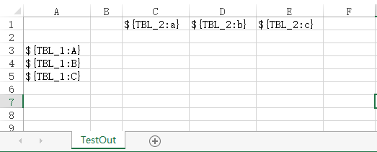
Area of “TBL_1”
Area of “TBL_2”

